Slide 1
Java Tests
By: Braden Harada

Slide 2
There are 4 Main types of tests
Unit Tests – Low level white box testing
Integration Tests – Medium level white box testing
System Tests – High level black box testing
User Tests – High level testing

Slide 3
Unit Tests
Validates the behavior of individual methods and classes.
Can test any method that has no dependency on other parts of the application
The industry standard tool for Java is JUnit
JUnit allows easy automation for regression tests and provides immediate results
Usually involves modifying an instance of a class to verify if the class was modified
Recommend using a distinct test class per class being tested

Slide 4
Integration Tests
Run on and between independent modules
Some modules can be:
A module for HTTP communication with a web server
A module for communication with a database
A module for reading and/or writing information or files to a disk
Many more…

Slide 5
System Tests
Can be completed by automated software or by a human
Check the functionality of the fully assembled application
Generally by opening the user interface and checking the functionality of every line of code including erroneous uses
Often, testers do not know the software or application and are hired to test multiple pieces

Slide 6
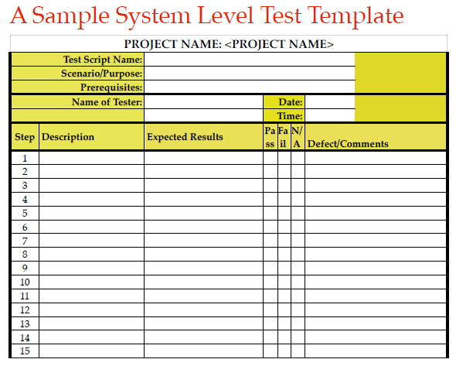
Test Template
This is a basic test template to give an idea of the basic structure of the System Tests that need to take place.
There are two columns so the tester can follow very specific steps and document the outcome of each step.
Each function of the program needs to be tested with actual and erroneous data to verify the results.

Slide 7
User Tests
Generally completed before the user interface is created
Users are given no documentation regarding the software
Testers do not give any clues or hints on how to accomplish tasks the users are given
The idea is to discover where the users struggle and improve that portion of the interface

Slide 8
Works Cited:
Doing More With Java – Android and Tomcat Edition, Section 3, pages 9 through 12
Lee S. Barney

